Slide 1
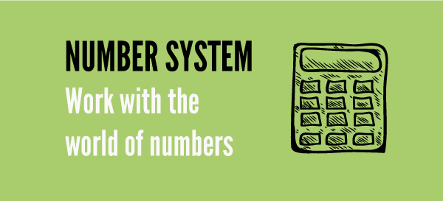
Number Systems

Slide 2

Content
TYPES OF NUMBERS
Conversion of a decimal number to fraction
DIVIDIBILITY RULE
POWER CYCLE
REMAINDER THEOREM
FACTORS AND MULTIPLES
i) Number of factors
ii) Sum of factors
iii) Product of factors
HCF & LCM
AP & GP

Slide 3
Face Value and Place value
4567
Face Value of 4 = 4
Face Value of 5 = 5
Face Value of 6 = 6
Face Value of 7 = 7
Place Value of 4 = 4000
Place Value of 5 = 500
Place Value of 6 = 60
Place Value of 7 = 7

Slide 4
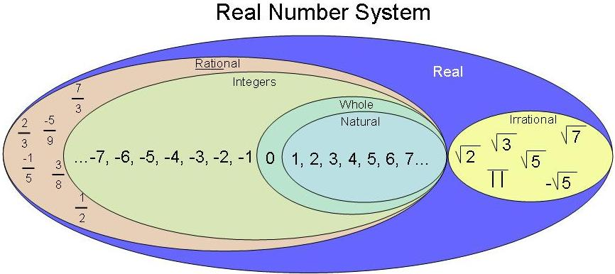
1. Types of numbers

Slide 5
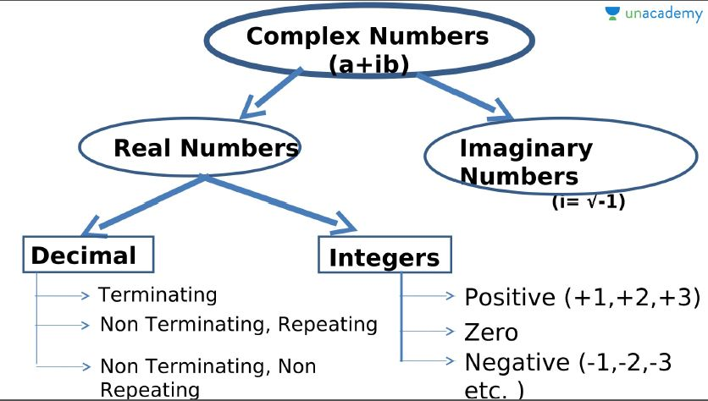

Slide 6
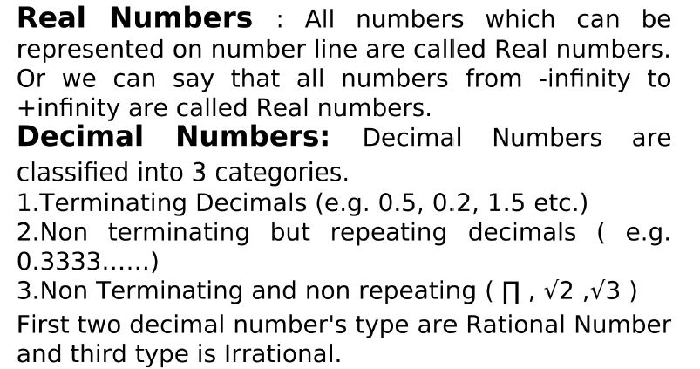

Slide 7
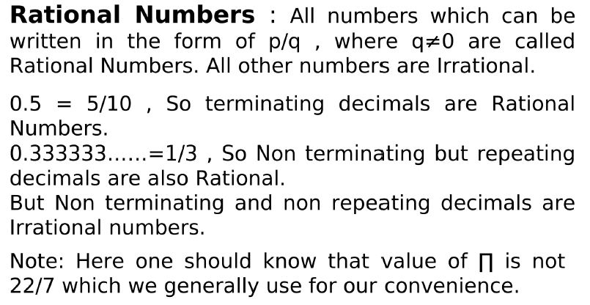

Slide 8
Rational no. b/w a and b = (ak+b)/(k+1)
Irrational no. b/w a and b = √ab, …..
How to find whether a no is Prime or not

Slide 9
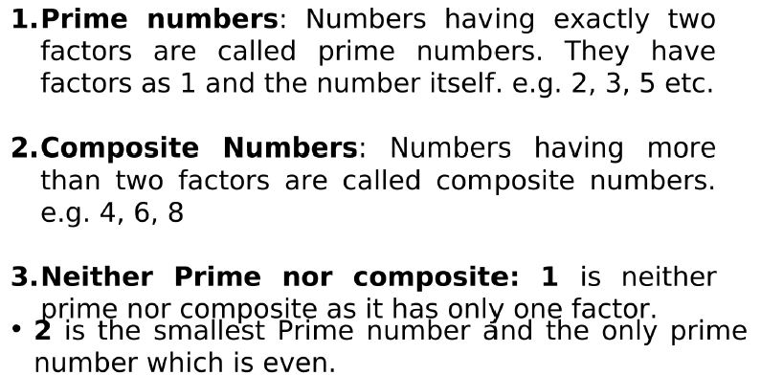
Positive Integers: Positive integers can be categories in many ways.

Slide 10
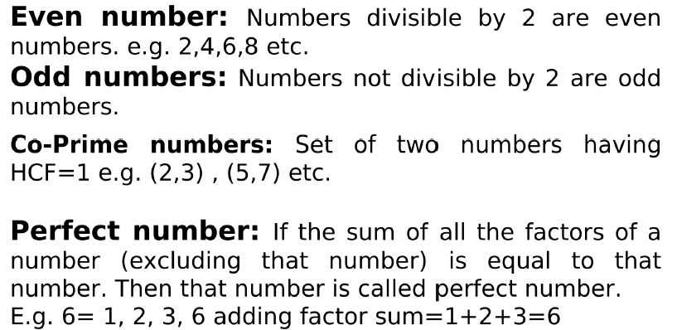

Slide 11
Important rules related to Even and Odd numbers:
odd ± odd = even;
even ± even = even;
even ± odd = odd
odd × odd = odd;
even × even = even;
even × odd = even.
odd^{(any number)} = odd
even^{(any number)} = even
How to find whether a no is Prime or not

Slide 12
1.i) How to find if a number is prime or not?
N is a prime number if it is not divisible by numbers lesser than √N.
Example: 191 is a prime number since it is not divisible by 2, 3, 5, 7, 11 and 13 [numbers less than √191 (≈14)].
Note: Prime numbers will always be in the form (6k±1) where k= 1, 2, 3....
But not all (6k±1) will be a prime number.
(6k±1)
prime numbers

Slide 13
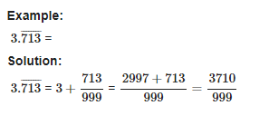
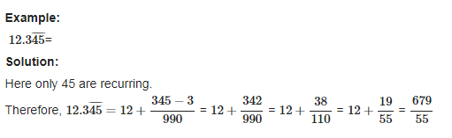
1.ii) Conversion of a decimal number to fraction:

Slide 14
Q. Convert 0.2333333333……………. into P/Q
A . 23/90
7/30
21/30
5/6
Ans- B

Slide 15
Q. Convert 37.565656565656……………. into P/Q

Slide 16
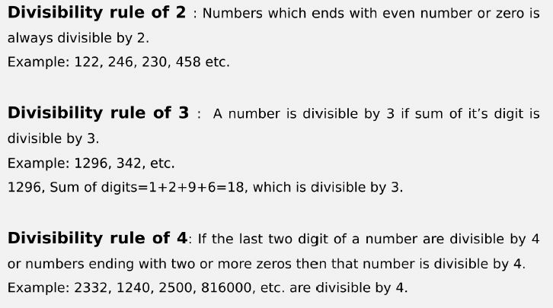
2. Divisibility Rules

Slide 17
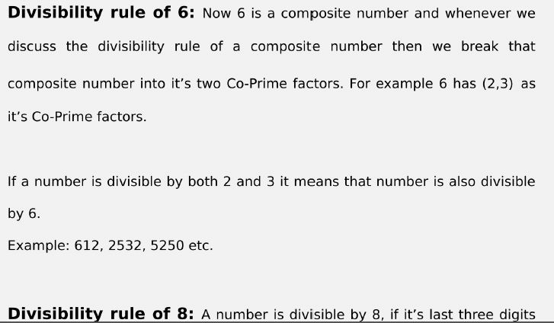

Slide 18
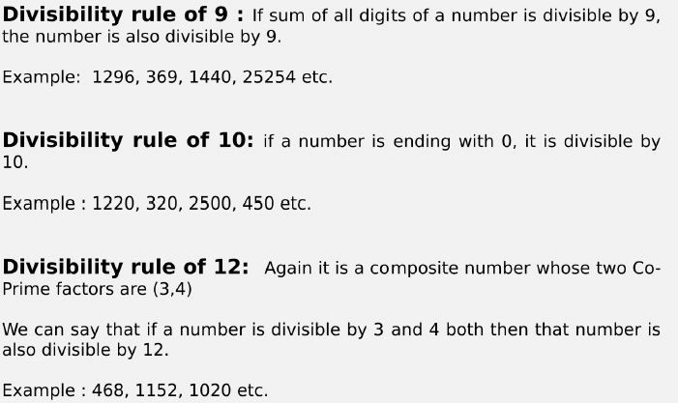

Slide 19
Any other numbers can be written in terms of the numbers whose divisibility is already known.
Example: 15 = 3 x 5
18 = 2 x 9
33 = 3 x 11
Note: The numbers expressed should be co-prime (i.e., the HCF of the two numbers should be 1)
Example: 40 = 4 x 10 is wrong because HCF(4,10) is 2.
∴ 40 = 5 x 8 because HCF(5,8) is 1.
How to find whether a no is Prime or not

Slide 20
Question: If number 1792N is divisible by 2. How many values N can take?
[A] 4
[B] 5
[C] 3
[D] 6
Ans - B

Slide 21
Question: What should come in place of x if 563x5 is divisible by 9?
[A] 7
[B] 8
[C] 9
[D] 2
Ans - B

Slide 22
Question: For what values of P number 345472P34 is exactly divisible by 9.
[A] 3
[B] 4
[C] 6
[D] 7
Ans - B

Slide 23
Question: For what values of N number 9724N is exactly divisible by 6.
[A] 2 & 8
[B] 4 & 6
[C] 2 & 6
[D] 6 & 8
Ans - A

Slide 24
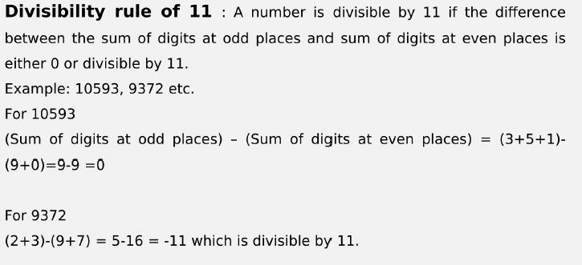

Slide 25
Question: For what values of N number 857N32 is exactly divisible by 11.
[A] 1
[B] 0
[C] 3
[D] 4
Ans - B

Slide 26
Question: What should come in place x if 4857x is divisible by 88?
[A] 6
[B] 8
[C] 2
[D] 4
Ans - A

Slide 27
Unit Digit Concept
Right most digit of a number is called Unit digit.
For e.g. 278 X 623 what will be the unit digit?

Slide 28
Unit digit questions can be asked in two ways:
Simple Product type Questions
e.g. What will be the unit digit of 123 X 456 X 789.
2. Power Type Questions
e.g. Find the unit digit of (127)^23
It can also be the mixture of both.

Slide 29
We can categories in three category:
Numbers ending with (0, 1, 5, 6)
Numbers ending with (4,9)
Numbers ending with (2,3,7,8)
Each category follow a certain rule.

Slide 30
Numbers ending with (0, 1, 5, 6) : Any number ending with 0, 1, 5, 6 raised to power any number (Except 0) will always have same number at unit place respectively.
For e.g. (2350)^234, (531)^34, (245)^321, (776)^321

Slide 31
2. Numbers ending with (4 and 9) : Cyclicity of 4 and 9 is 2. It means their unit digit repeats after every 2 powers. So we can say
4^Odd = 4 at unit place
4^ Even = 6 at unit place
9^Odd = 9 at unit place
9^ Even = 1 at unit place

Slide 32
3. Numbers ending with (2,3,7,8) : All numbers have cyclicity of 4, it means after every 4th power the unit digit pattern will be same.
In these type of questions we will divide the power by cyclicity (i.e. 4) so that we will know how many cycles have been completed and we will try to find remainder. And unit digit will be (2,3,7,8)^Rem
Note: If remainder is zero then we take highest power of that cycle which is 4. or we can say (2,3,7,8)^4

Slide 33
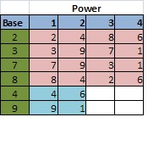
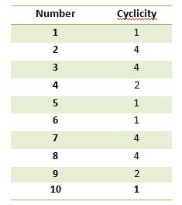
Choose the nth value in the cycle if the remainder is n except for the last value whose remainder should be 0.

Slide 34
Example 2: What is the unit digit of (123)^42?
The unit digit pattern of 3 repeats four times. So find the remainder when the power value is divided by 4.
42/4= R(2)
2nd value in 3 cycle is 9.
∴ Unit digit of (123)^42 is 9
How to find whether a no is Prime or not

Slide 35
Q) What is the unit digit of (127)^223
7 B) 9 C) 3 D) 1
Ans- C

Slide 36
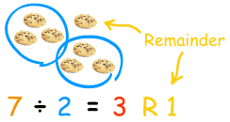
4. Remainder theorem
Type 1: Numerator in terms of powers
The remainder pattern should be found starting from the power of 1. The same procedure should be followed as done in the unit digit concept.

Slide 37
Example: What is the remainder when 2^202 is divided by 7?
2^1/7 = R(2)
2^2/7= R(4)
2^3/7 = R(1)
The next three remainder values will be the same. i.e., The remainder pattern is 2,4,1, 2,4,1, 2,4,1.....
The size of the pattern is 3.
Now divide the power by number of repeating values (3) to choose the remainder.
Choose the nth value in the cycle if the remainder is n except for the last value whose remainder should be 0.
202/3 = R(1).
The 1st value in the cycle is 2.
Note: While finding the remainder pattern if the remainder becomes 1, then the process can be stopped as the it will always repeat after 1.
∴ 2^202/7 = R(2)

Slide 38
Note: While finding the remainder pattern if the remainder becomes 1, then the process can be stopped as the it will always repeat after 1.

Slide 39
Type 2: Different numerator values
Replace each of the values of the numerator by its remainder when divided by the denominator and simplify.
Example: What is the remainder when 13 x 14 x 16 is divided by 6.
13/6 = R(1) ∴ replace 13 by 1
Similarly replace 14 and 16 by 2 and 4 respectively.
∴ (13 x 14 x 16)/6 = (1 x 2 x 4)/6
= 8/6
= R(2)

Slide 40
Note: Do not cancel any numerator value with the denominator value as the remainder will differ.
R(6/4) ≠ R(3/2)
6/4 = R(2)
But 3/2 = R(1)

Slide 41
Q) What is the remainder when 3 to the power 7 is divided
by 8?
A)3
B)4
C)5
D)7
E)None
Ans- A

Slide 42
Q) Remainder when 17^23 is divided by 16?
A)1
B)2
C)3
D)4
Ans- A

Slide 43
Q) Remainder when 35^113 is divided by 9?
A)1
B)8
C)3
D)4
Ans- B

Slide 44
Q) Remainder when 2^33 is divided by 9?
A)1
B)4
C)8
D)5
Ans- C

Slide 45
Q) Remainder when 2^99 is divided by 10?
A)1
B)4
C)2
D)8
Ans- D

Slide 46
Q) Remainder when 5^500 is divided by 500?
A)125
B)1
C)5
D)250
Ans- A

Slide 47
5. Factors
Factors of a number are the values that divides the number completely.
Example: Factors of 10 are 1, 2, 5 and 10.
Multiple of a number is the product of that number and any other whole number.
Example: multiples of 10 are 10, 20, 30,…..

Slide 48
Factors
Total Number of Factors
Sum of Factors
Number of Odd Factors
Number of Even Factors
The number of ways of writing a number N as a product of two number
The number of ways of writing a number N as a product of two co-prime numbers

Slide 49
5.i) Total Number of factors:
Take any number “N” and it is to be covert into product of prime numbers (Prime factorization) i.e
N = A^{p} x B^{q} x C^{r} here A, B , C are prime numbers and p, q, and r were respective powers of that prime numbers.
Total numbers of factors for ” N “= (p + 1)(q +1)(r +1).

Slide 50
Example: 3600
Step 1: Prime factorize the given number
3600 = 36 x 100
= 6^2 x 10^2
= 2^2 x 3^2 x 2^2 x 5^2
= 2^4 x 3^2 x 5^2
Step 2: Add 1 to the powers and multiply.
(4+1) x (2+1) x (2+1)
= 5 x 3 x 3
= 45
∴ Number of factors of 3600 is 45.

Slide 51
Q) Find the number of factors of 144?
15 B) 12 C) 8 D) none
Ans- A

Slide 52
Q) Find the number of factors of 14400?
24 B) 54 C) 63 D) none
Ans- C

Slide 53
Q) Find the number of factors of 120?
15 B) 16 C) 12 D) none
Ans- B

Slide 54
5.ii) Sum of factors:
Example: 45
Step 1: Prime factorize the given number
45 = 3^2 x 5^1
Step 2: Split each prime factor as sum of every distinct factors.
(3^0 + 3^1 + 3^2) x (5^0 + 5^1)
The following result will be the sum of the factors
= 78

Slide 55
Q) find the sum of factors of 98?
161 B) 171 C) 160 D) none
Ans- B

Slide 56
Q) find the sum of factors of 300?
A) 768 B) 868 C) 860 D) none
Ans- B

Slide 57
5.iii) Number of ODD factors:
Example: 4500
4500 = 45 x 100 = 9 x 5 x 10 x 10 = 3 x 3 x 5 x 5 x 2 x 5 x 2
4500 = 2² x 3² x 5³ Here consider A = 2 , B = 3 , C = 5 , p= 2 , q = 2 and r = 3
Here identifying that odd number are 3 and 5
Numbers of odd factors of number 4500 = (q + 1 ) (r + 1) = 3 x 4 = 12
Note: Do not consider even prime factor

Slide 58
5.iv) Number of Even factors:
Numbers of even factors of number = Total number of factors – Numbers of odd factors
Example: 4500
4500 = 45 x 100 = 9 x 5 x 10 x 10 = 3 x 3 x 5 x 5 x 2 x 5 x 2
4500 = 2² x 3² x 5³ Here consider A = 2 , B = 3 , C = 5 , p= 2 , q = 2 and r = 3
Here identifying that odd number are 3 and 5
Numbers of odd factors of number 4500 = (q + 1 ) (r + 1) = 3 x 4 = 12
Total number of factors = (p + 1)(q +1)(r +1) = 3 x 3 x 4 =36
Numbers of even factors of number = Total number of factors – Numbers of odd factors = 36 – 12 = 24
Note: Do not add 1 in the power of the even prime factor

Slide 59
Q) How many factors of 2⁴ * 5³ * 7⁴ are odd numbers?
100 B) 99 C) 20 D) 24
Ans- C

Slide 60
Q) How many factors of 360 are odd numbers?
A) 24 B) 6 C) 18 D) 12
Ans- B

Slide 61
Q) Number N = 2⁶ * 5⁵ * 7⁶ * 10⁷; how many factors of N are even numbers?
A) 1183 B) 1200 C) 1050 D) 840
Ans- A

Slide 62
Q) How many factors of 120 are even numbers?
A) 4 B) 16 C) 18 D) 12
Ans - D

Slide 63
5.v) The number of ways of writing a number N as a product of two number :
The number of ways of writing a number as a product of two number = [(p+1).(q+1).(r+1)...]/2
Example:
Find no. of ways of writing 140 as a product of two numbers
The prime factorization of 140 = 2^2×5×7
number of ways = (3*2*2)/2 = 6
Note: If the total number of factors are odd then
Product of two number= (total factors+1)/2

Slide 64
5.vi) The number of ways of writing a number N as a product of two co-prime numbers:
The number of ways of writing a number N as a product of two co-prime numbers = 2^(n−1)
where n=the number of prime factors of a number.
Example:
The prime factorization of 60 = 2^2×3×5
The no of ways of writing 60 as a product of two co - primes = 2^(3−1) = 4

Slide 65
Q) Find no. of ways of writing 120 as a product of two numbers
A) 8 B) 4 C) 9 D) none
Ans- A

Slide 66
Q) Find no. of ways of writing 144 as a product of two numbers
A) 7 B) 8 C) 9 D) none
\\\\\\\\\\\\\\\\\\\\\\\\\\\\\\\\\\\\\\
Ans- B

Slide 67
Q) Find no. of ways of writing 120 as a product of two co-prime numbers
A) 3 B) 4 C) 8 D) none
Ans- B

Slide 68
Q) How many factors of 21600 are perfect square?
A) 12 B) 10 C) 6 D) none
Ans- A

Slide 69
Q) How many factors of 21600 are perfect cube?
A) 5 B) 4 C) 6 D) none
Ans- B

Slide 70
Q) find the sum of Odd factors of 360?
A) 61 B) 78 C) 1092 D) none
Ans- B

Slide 71
Q) find the sum of Even factors of 360?
A) 1170 B) 78 C) 1092 D) none
Ans- C

Slide 72
Factors will occur in pairs for the numbers except perfect squares.
Example 1: A non perfect square number- 10
1 x 10 = 10
2 x 5 = 10
‘∴ Factors of 10 are 1, 2, 5 and 10.
Non perfect squares will have even number of factors

Slide 73
Example 2: A perfect square number- 16
1 x 16 = 16
2 x 8 = 16
4^2 = 16
∴ Factors of 16 are 1, 2, 4, 8 and 16.
Every perfect square will have odd number of factors because its square root number will pair with itself.
This has odd number of factors because 4 will pair with itself.
Every perfect square will have odd number of factors because its square root number will pair with itself.

Slide 74
Example 3: A prime square number- 49
The factors of 49 are 1, 7 and 49.
Prime square number will have exactly 3 factors (1, that number itself and square root of that number).
If N is a prime square number then the factors are 1, N and √N.

Slide 75
Q) If 11^2, 3^4 and 2^5 are the factors of a x 12^7 x 17^6 x 21^5 then what is the minimum possible value of a?

Slide 76
Number of Trailing Zeroes

Slide 77
Number of trailing zeroes in a Product or Expression
Number of trailing zeroes is going to be the power of 2 or 5, whichever is lesser.
Or maximum pairs of (2 x 5)
Example: Find the number of zeros in 2¹⁵⁰ x 5²³⁴ x 3¹⁶⁰

Slide 78
Number of trailing zeroes in a factorial (n!)
Number of trailing zeroes in n! = Highest power of 5 in n!
Example: Find the number of Zeroes in 50!

Slide 79
Q. How many zeros are there in 100!?
a) 24 b) 97 c) 121 d) none
Ans- A

Slide 80
Q) Find the number of zeros in 75!
a) 16 b) 18 c) 20 d) 21
Ans- B

Slide 81
Q)Find the number of zeros in 255!
a) 63 b) 52 c) 62 d) 65
Ans- A

Slide 82
Q) Find the number of zeros at end of
5 x 10 x 15 x 20 x 25 x 30 x 35…………… x 240 x 245 x 250
a) 53 b) 62 c) 47 d) none
Ans- C

Slide 83
Q) Find the number of zeros in 100! + 200!
a) 24 b) 49 c) 73 d) none
Ans- A

Slide 84
Q) Find the number of zeros in 100! * 200!
a) 24 b) 49 c) 73 d) none
Ans- C

Slide 85
6. HCF & LCM
The greatest number that will exactly divide a, b and c is HCF(a, b, c).
The greatest number that will divide a, b and c leaving remainder of x, y and z respectively is HCF(a-x, b-y, c-z).
The greatest remainder which when it divides a, b and c will leave the same remainder in each case is HCF(a-b, b-c, c-a).
The least number which is exactly divisible by a, b and c is LCM(a, b, c).
The least number which when divided by a, b and c leaves the same reminder r in each case is LCM(a, b, c) + r.
The least number which when divided by a, b and c leaves the remainder x, y and z respectively is LCM(a, b, c) – K.
This is possible only if a-x = b-y = c-z = K.

Slide 86
FINDING THE H.C.F. OF BIG NUMBERS
For larger numbers you can use the following method:
Step 1 Find all prime factors of both numbers.
Step 2 Write both numbers as a multiplication of prime numbers.
Step 3 Find which factors are repeating in both numbers and multiply them to get H.C.F

Slide 87
FINDING L.C.M. OF BIG NUMBERS
Step 1 Find all the prime factors of both numbers.
Step 2 Multiply all the prime factors of the larger number by those prime factors of the smaller number that are not already included

Slide 88

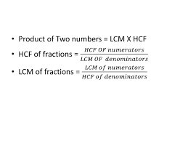
Important formulae:

Slide 89
Q) Find the lowest common multiple of 24, 36 and 40.
A) 120 B) 240 C) 360 D) 480
Ans- C

Slide 90
Q) The least number which is exactly divisible by
8, 16, 40 and 80 is:
A) 16 B) 120 C) 80 D) none
Ans- C

Slide 91
Q) Find the highest common factor of 36 and 84.
A) 4 B) 6 C) 12 D) 18
Or, The greatest number that will exactly divide 36 and 84 is:
Ans- C

Slide 92
Q) The greatest possible length which can be used to measure exactly the lengths 7 m, 3 m 85 cm, 12 m 95 cm is:
A) 15 B) 25 C) 35 D) 42
Ans- C

Slide 93
Q) Four bells ring at an interval 3min, 4min, 5min and 6 minutes respectively. If all the four bells ring at 9am first, when will it ring again?
Ans- 10 AM

Slide 94
Q) The H.C.F. of two numbers is 11 and their L.C.M. is 7700. If one of the numbers is 275, then the other is:
A)308
B)310
C)312
D)None
Ans- A

Slide 95

Q) The H.C.F of 9/10, 12/25, 18/35, and 21/40 is?
A)3/1400
B)5/1400
C)7/1400
D)None
Ans- A

Slide 96
Q) Which of the following fraction is the largest? 7/8, 13/16, 31/40, 63/80
A)7/8
B)13/16
C)31/40
D)63/80
Ans- A

Slide 97
Q) Three number are in the ratio of 3 : 4 : 5 and their L.C.M. is 2400. Their H.C.F. is:
A) 40 B) 80 C) 120 D) 200
Ans- A

Slide 98
Q) The ratio of two numbers is 3 : 4 and their H.C.F. is 4. Their L.C.M. is:
A) 12 B) 16 C) 24 D) 48
Ans- D

Slide 99
Q) The least number, which when divided by 12, 15, 20 and 54 leaves in each case a remainder of 8 is:
A) 504 B) 536 C) 544 D) 548
Ans- D

Slide 100
Q) Find the smallest number, which when divided by 3, 4 and 5 leaves remainder 1, 2 and 3 respectively?
A) 60 B) 53 C) 58 D) none
Ans- C

Slide 101
Q) The greatest number which on dividing 1657 and 2037 leaves remainders 6 and 5 respectively, is:
A) 123 B) 127 C) 235 D) 305
Ans- B

Slide 102
Q) Find the greatest number that will divide 43, 91 and 183 so as to leave the same remainder in each case.
A) 4 B) 7 C) 9 D) 13
Ans- A

Slide 103
Q) The product of two numbers is 4107. If the H.C.F. of these numbers is 37, then the greater number is:
A) 101 B) 107 C) 111 D) 185
Ans- C

Slide 104
Q) The product of two numbers is 2028 and their H.C.F. is 13. The number of such pairs is:
A) 1 B) 2 C) 3 D) 4
Ans- B

Slide 105
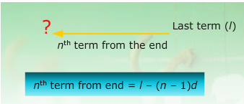
ARITHMETIC PROGRESSION
An Arithmetic Progression (A.P.) is a sequence in which the difference between any two consecutive terms is constant.
Let a = first term, d = common difference
Then nth term

Slide 106


Sum of an A.P

Slide 107
AM (Arithmetic mean)
If a, b, c are in AP then the arithmetic mean is given by
b = (a+c)/2

Slide 108
Inserting AM
To insert k means between a and b the formula for common difference is given by
d = (b-a) / (k+1)
For example: Insert 4 AM’s between 4 and 34
d= (34 - 4) / (4+1)
= 30/5
= 6
∴ The means are 4+6=10
10+6=16
16+6=22
22+6=28

Slide 109
1,3,5, 7, …….. Which term of this AP is 55?
A) 25th B) 26th C) 27th D) 28th
Ans-D

Slide 110
Q) Find the 15th term of the series 20,15,10,……..
A) -45 B) -50 C) -55 D) 0
Ans-B

Slide 111
Q)How many terms are there in the AP 20, 25, 30, …….. 130?
A) 21 B) 22 C) 23 D) 24
Ans-C

Slide 112
Q) Find the sum of the series 5,8,11,…….. 221
A) 8249 B) 8239 C) 7886 D) 9000
Ans- A

Slide 113
Q) Find the sum of all 2-digit numbers, which are exactly divisible by 9?
A) 525 B) 565 C) 575 D) 585
Ans-D

Slide 114
Q) Find the first term of an AP whose 8th and 12th terms are 39 and 59 respectively?
A) 3 B) 4 C) 5 D) 6
Ans-B

Slide 115
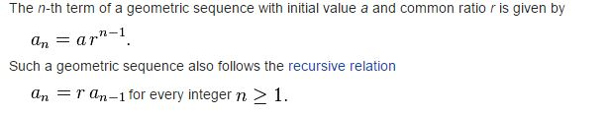
GEOMETRIC PROGRESSION
A geometric sequence are powers r^{k} of a fixed number r, such as 2^{k} and 3^{k}. The general form of a geometric sequence is

Slide 116
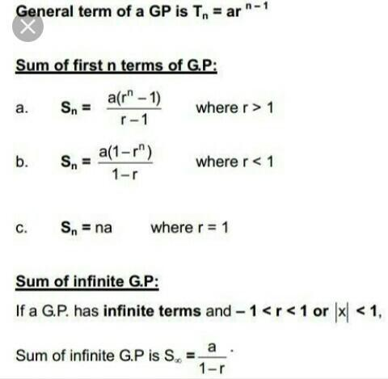

Slide 117
GM ( Geometric mean)
If a, b, c are in GP Then the GM is given by
b = √ac

Slide 118
Inserting GM
To insert k means between a and b the formula for common ratio is given by
r = (b/a)^(1/(k+1))
For example: Insert 4 GM’s between 2 and 486
r = (486/2)^(1/(4+1))
= (243)^(1/5)
= 3
∴ the means are 2x3 = 6
6x3 = 18
18x3 = 54
54x3 = 162

Slide 119
Q) How many terms are there in the sequence
5, 20, 80, 320, …….. 20480?
A) 5 B) 6 C) 7 D) 8
Ans-C

Slide 120
Q) If the first and fifth term of a GP are 16 and 81 respectively then find the fourth term?
A) 18 B) 24 C) 36 D) 54
Ans-D

Slide 121
Q) Find the sum of the series 2, 4, 8, 16…. 256.
A)510 B) 1020 C) 520 D) none
Ans-A

Slide 122

Next Class Averages

